Slide 1



Slide 2
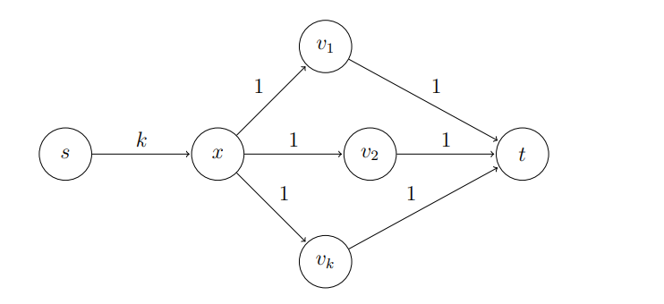
Goal & Motivation
Find a maximal flow over a directed graph
Source and sink vertices are given
Ford Fulkerson vs Push Relabel on the below network

Slide 3
Basic Definitions
A flow network ➔ G = (V,E) a directed graph
Two vertices {s, t} the source and the sink
Each edge (u,v) ∈E has some positive capacity c(u,v), if (u,v) ∉E c(u,v) =0.
The flow function f maps a value for each edge where:
  f(u,v) ≤ c(u,v)
  f(v,u) = - f(u,v) ( anti symmetry )
Saturated edge (u,v) ⬄ c(u,v) = f(u,v)

Slide 4
Basic definitions, contd.
r(u, v) = c(u,v) – f(u,v)
Residual graph R(V, E`) where E` is all the edges (u,v) where r(u,v) ≥0
Augmenting path p is a path from to the source to the sink over the residual graph
Important Result already Proved in Class
f is a maxflow ⬄ there is no path from source to sink in resisual graph

Slide 5
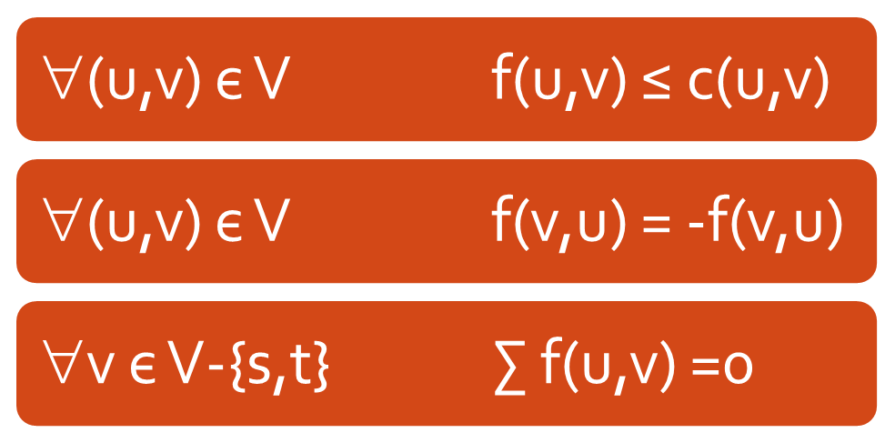
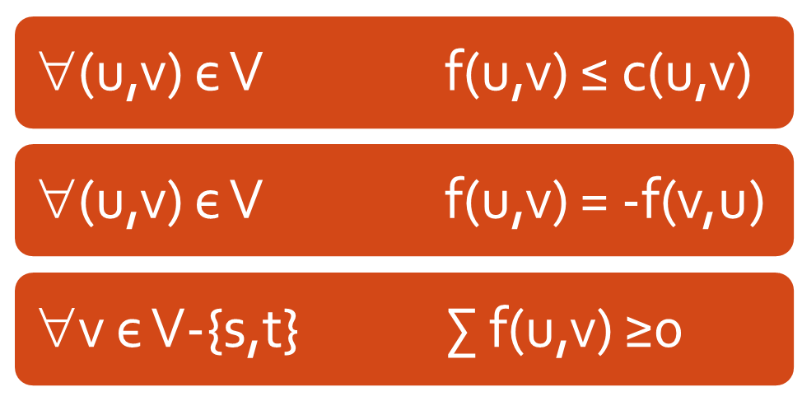
Preflow
Flow constrains:
Every vertex v may keep some “excess” flow e(v) inside the vertex

Slide 6
Excess handling
We strive to push this excess toward the sink
How do we push this excess flow (Push(v)) & types of push
If the sink is not reachable on the residual network the algorithm pushes the excess toward the source
When no vertices with e(v) >0 are left the algorithm halts, and the resulting flow (!) is the max –flow

Slide 7
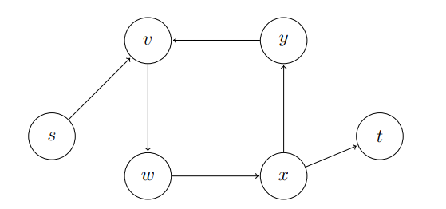
Limitations of Push & Solution
Just pushing flow around the residual network is not enough to obtain a correct maximum flow algorithm.

Slide 8
Heights & Invariants
A mapping function h(v) → N + { ∞ }
h(s) = n, h(t) = 0
r(u,v) > 0 → h(u) ≤ h(v)+1
Lemma 1: If s-t flow f is compatible with labelling h, then f is maximum value

Slide 9
Active vertex
Active vertex:
  v є V-{s,t} is active if
    h(v) < ∞
    e(v) > 0
    The first condition is always true (proved later) so only second condition is essential

Slide 10
Basic operations
Applied on active vertices only
Push (u,v)
  Requires: r(u,v) >0, h(u)=h(v)+1
  Action:
    δ = min( e(v) , r(u,v) )
    f(u,v) += δ, f(v,u) -= δ
    e(u) -= δ , e(v) += δ

Slide 11
Basic operations , contd.
Relabel (u)
  Requires: ∀(u,v) є V r(u,v) >0 → h(u) ≤ h(v)
  Action:
    h(u) = h(u)+1 or min { h(v) +1 | r(u,v) >0 } (Both relabel operations are correct, anyone of them can be used)
One of the basic operations is applicable on a active vertex:
  PUSH: Any residual edge (u,v) with h(u) = h(v) +1
  Otherwise: h(u) ≤ h(v) for all residual edges, allows relabel

Slide 12
The algorithm
Initialize: h(s) = n, v є V-{s} h(v) =0
Saturate the outgoing edges of s
While there are active vertices apply one of the basic actions on the vertex
Simple, isn’t it?
Let’s see an example

Slide 13
Example
- Saturate all source edges
4
4
0
2
2
2
S
0
T
2
2
4
1
0
0

Slide 14
Example – contd.
4,4
4
2
2
2
S
2
T
2,2
4
1
0
0
4
0
2
2
2
6
0
0
2
4
1
0
0
Relabel

Slide 15
Example – contd.
4,4
4
2
2
2
S
2
T
2,2
4
1
0
0
4
0
2
2
2
6
1
0
2
4
1
0
0
Push

Slide 16
Example – contd.
4,4
6
2
2,2
2
S
0
T
2,2
4
1
0
0
Relabel
4
0
2
2
2
6
1
0
2
4
1
0
0

Slide 17
Example – contd.
4,4
6
2
2,2
2
S
0
T
2,2
4
1
0
0
Push (twice)
4
1
2
2
2
6
1
0
2
4
1
0
0

Slide 18
Example – contd.
4,4
2
2,2
2,2
2,2
S
0
T
2,2
4
1
0
2
4
1
2
2
2
6
1
0
2
4
1
0
Relabel
0

Slide 19
Example – contd.
4,4
2
2,2
2,2
2,2
S
0
T
2,2
4
1
0
2
Push
4
2
2
2
2
6
1
0
2
4
1
0
1

Slide 20
Example – contd.
4,4
0
2,2
0,2
2,2
S
2
T
2,2
4
1
0
2
4
2
2
2
2
6
1
0
2
4
1
0
1
Relabel, Push

Slide 21
Example – contd.
4,4
2
2,2
2,2
2,2
S
0
T
2,2
4
1
0
2
Relabel, Push
4
2
2
2
2
6
3
0
2
4
1
0
1

Slide 22
Example – contd.
4,4
0
2,2
0,2
2,2
S
2
T
2,2
4
1
0
2
4
4
2
2
2
6
3
0
2
4
1
0
1
Relabel, Push

Slide 23
Example – contd.
4,4
2
2,2
2,2
2,2
S
0
T
2,2
4
1
0
2
Relabel, Push
4
4
2
2
2
6
5
0
2
4
1
0
1

Slide 24
Example – contd.
4,4
0
2,2
0,2
2,2
S
2
T
2,2
4
1
0
2
4
6
2
2
2
6
5
0
2
4
1
0
1
Relabel, Push

Slide 25
Example – contd.
4,4
2
2,2
2,2
2,2
S
0
T
2,2
4
1
0
2
Relabel, Push
4
6
2
2
2
6
7
0
2
4
1
0
1

Slide 26
Example – contd.
2,4
0
2,2
2,2
2,2
S
0
T
2,2
4
1
0
2
2,2
7
2
2
2
6
7
0
2
4
1
Push
0
1

Slide 27
Example – contd.
2,4
0
2,2
2,2
2,2
S
0
T
2,2
2,4
1
2
0
2,2
7
2
2
2
6
7
0
2
2,2
1
0
Relabel
1

Slide 28
Example – contd.
2,4
0
2,2
2,2
2,2
S
0
T
2,2
2,4
1
2
0
2,2
7
2
2
2
6
7
0
2
2,2
1
1
Push
1

Slide 29
Example – contd.
2,4
0
2,2
2,2
2,2
S
0
T
2,2
2,4
1,1
1
0
2,2
7
2
2
2
6
7
0
2
2,2
1
1
Relabel, Push
1

Slide 30
Example – contd.
2,4
0
2,2
2,2
2,2
S
0
T
2,2
1,4
1,1
0
1
2,2
7
2
2
2
6
7
0
2
3,1
1
2
Relabel, Push
1

Slide 31
Example – contd.
2,4
0
2,2
2,2
2,2
S
0
T
2,2
2,4
1,1
1
0
2,2
7
2
2
2
6
7
0
2
2,2
1
2
Relabel, Push
3

Slide 32
Example – contd.
2,4
0
2,2
2,2
2,2
S
0
T
2,2
1,4
1,1
0
1
2,2
7
2
2
2
6
7
0
2
3,1
1
4
Relabel, Push
3

Slide 33
Example – contd.
2,4
0
2,2
2,2
2,2
S
0
T
2,2
2,4
1,1
1
0
2,2
7
2
2
2
6
7
0
2
2,2
1
4
Relabel, Push
5

Slide 34
Example – contd.
2,4
0
2,2
2,2
2,2
S
0
T
2,2
1,4
1,1
0
1
2,2
7
2
2
2
6
7
0
2
3,1
1
6
Relabel, Push
5

Slide 35
Example – contd.
2,4
0
2,2
2,2
2,2
S
0
T
2,2
2,4
1,1
1
0
2,2
7
2
2
2
6
7
0
2
2,2
1
6
Relabel, Push
7

Slide 36
Example – contd.
2,4
0
2,2
2,2
2,2
S
0
T
2,2
1,4
1,1
0
1
2,2
7
2
2
2
6
7
0
2
3,1
1
8
Relabel, Push
7

Slide 37
Example – contd.
2,4
1
2,2
2,2
1,2
S
0
T
2,2
1,4
1,1
0
0
Push
2,2
7
2
2
1,1
6
7
0
2
3,1
1
8
8

Slide 38
Example – contd.
1,4
0
2,2
2,2
1,2
S
0
T
2,2
1,4
1,1
0
0
3,1
7
2
2
1,1
6
7
0
2
3,1
1
8
8

Slide 39
Correctness
At the end, for all the vertices besides {s,t} no excess is left in the vertices
  ➔ Our preflow is a flow
The sink is not reachable from the source on the augmenting graph
  Let p= s, v₁ ,v₂ , v_{3….} v_{k} ,t be a path s→t
  Notice k ≤ n-2
  n = h(s) ≤ h(v₁) + 1 ≤ h(v₂) + 2 ... ≤ h(t) + k+1 = k+1
  Implies that n ≤ n-1 in contradiction to above

Slide 40
Complexity Analysis
Key Lemma: Let f be a preflow. If the node v has excess, there is a path in Gf (residual graph) from v to the source s
  A is set of all vertices that have a path till the s in residual graph
  There exist no edge e = ( x, y) leaving A with positive flow value
  All the nodes with positive excess is in A.

Slide 41
Bound on Height of Vertex:
Claim: h(v) ≤ 2*n – 1
From previous key lemma, there exist a path from v to s in residual graph.
Using the fact that along the path height decreases by at most 1 (steepness constraint)
Thus, h is finite for any v during the run of the algorithm

Slide 42
Bound on number of Relabels
Claim: Throughout the algorithm, each node is relabeled at most 2n-1 times, and total number of relabeling operations is O(n²)

Slide 43
Bound on number of Push
Amount of push is bounded by the excess on a vertex and residual capacity in the residual Graph.
Saturating Pushes: capacity of the edge is bottleneck
Non-Saturating Pushes: excess on the vertex is bottleneck

Slide 44
Bound on number of Saturating Push
Claim: Throughout the algorithm, the number of saturating push operations is at most O(nm)
Observation: Between two saturating pushes of the edge e = ( v, w ), each vertex {v,w} is relabelled atleast twice.
Label of vertex can increase by 2 atmost n-1 times, hence saturating pushes can occur at most n times.
There are m edges, hence bound O(nm)

Slide 45
Bound on Non-Saturating Pushes
Claim: Throughout the algorithm, the number of non-saturating push operations is at most O(mn²)
Potential: Φ = ∑h(v), for v with positive excess
  Φ is Zero in the beginning and in the end
A saturating push increases Φ by ≤ 2n-1
  All saturating pushes worth O(mn²)
A relabeling increases Φ by exactly 1
  All relabeling worth O(n²)
A Non-Saturating push decreases Φ by at least 1
Thus, there are up to O(mn²), Non-Saturating push

Slide 46
Complexity analysis
Any reasonable sequential implementation will provide us a polynomial algorithm
  How much a relabel operation cost? O(n²)
  How much a push operation cost? O(n²m)
  How much cost to hold the active vertices? O(1)

Slide 47
Chose the Vertex with maximum Height
Claim 5: If at each step we choose the node with excess at maximum height, then the number of non saturating push operations is at most 4n³ down from 2mn²
Theorem: Push Relabel runs in O(n³) time

Slide 48
Code Demonstration and Interesting Results

Slide 49
Questions?
Thank you for listening

